Slide 1
Hill Cipher
Implemented using Haskell

Slide 2
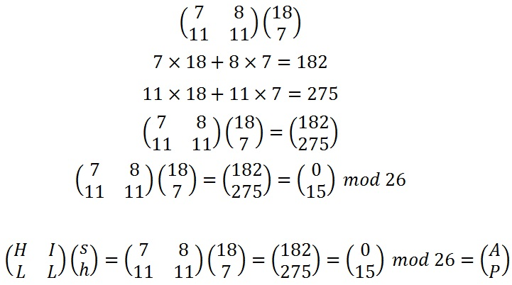
What is Hill Cipher?
In short, Matrix Multiplication!
Image 01: Encoding ‘sh’ with Hill Cipher

Slide 3
What is Hill Cipher?
In short, Matrix Multiplication!
Image 01: Encoding ‘sh’ with Hill Cipher

Slide 4
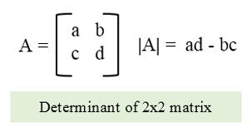
How it works: Before Encrypting
Each letter in the alphabet used is represented by a number modulo the size of the alphabet (so 26 for English)
The key matrix must be an invertible matrix
Must be square (n x n) in size
d*d⁻¹ ≡ 1 mod 26 – look familiar?
The determinant of the key matrix cannot share factors with the modulo
Finally, separate your message into n size chunks
Remember to pad your text to ensure it is the correct size!
Image 02: The most basic determinant
Notes:
If the determinant DOES share factors with the matrix, then trying to decrypt becomes impossible as it would become ambiguous

Slide 5
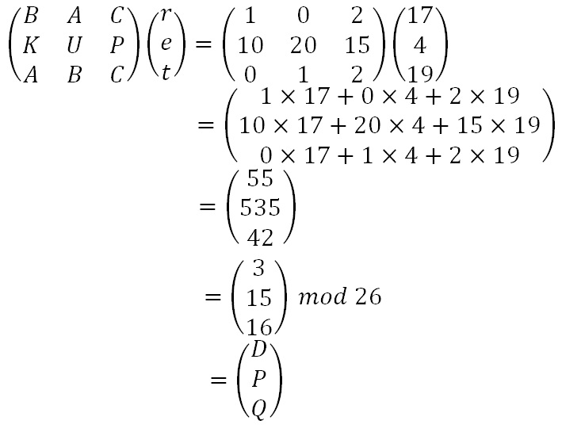
Encryption
Perform matrix multiplication on each block of your message!
Image 03: Given part ‘ret’ of ‘retreat nowxx’ and the key ‘BAC/KUP/ABC’

Slide 6
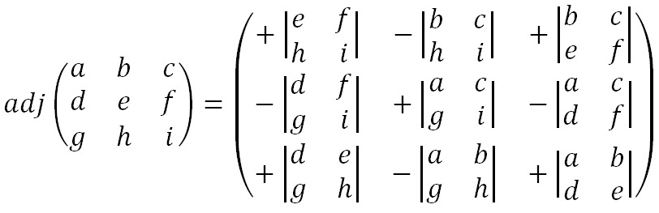
Decryption
Find the inverse of the key matrix
Multiply the inverse of the key’s determinant by the adjugate matrix of the key
In proper terms, given matrix M, determinant D, and adjugate Adj:
M⁻¹ = D⁻¹ x Adj
Then, multiply your encoded message with the resulting M⁻¹ matrix
Image 04: The Adjugate of a 3 x 3 matrix

Slide 7
Advantages and Disadvantages of Hill
Advantages:
Good masking of original message
Useful as an intermediary step in other ciphers, like AES, due to diffusion
Disadvantages:
Is completely linear
Restrictions on the Key matrix, coupled with size of key, produce finite possible keys
Becomes incredibly laborious to do by hand with longer keys/messages
Notes:
Confusion = mask relationship between ciphertext and Key
Diffusion = mask relationship between ciphertext and plaintext

Slide 8
Our Implementation
Key and message are input by the user
The key must be 4 characters long, in order to fit a 2x2 matrix
Encryption text is padded with ‘x’ to ensure the number of characters is divisible by 2, and to separate duplicate letters
For example, ‘hello’ becomes ‘helxleox’
Decryption checks the message to ensure it is divisible by 2, but does not pad

Slide 9
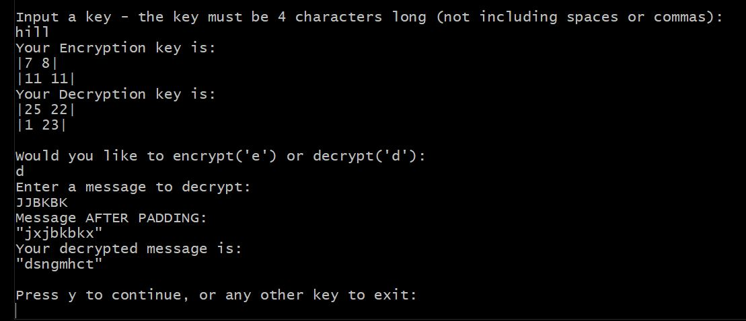
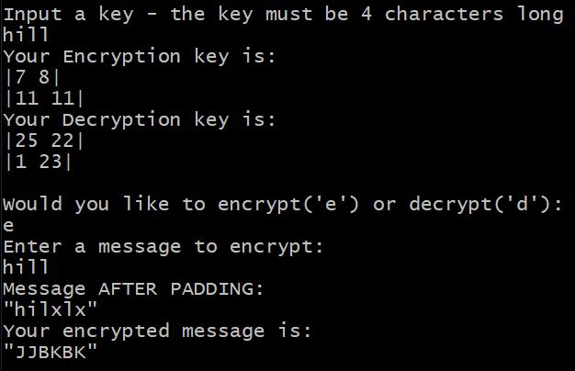
Program Example
Example of Decryption if it used padding

Slide 10
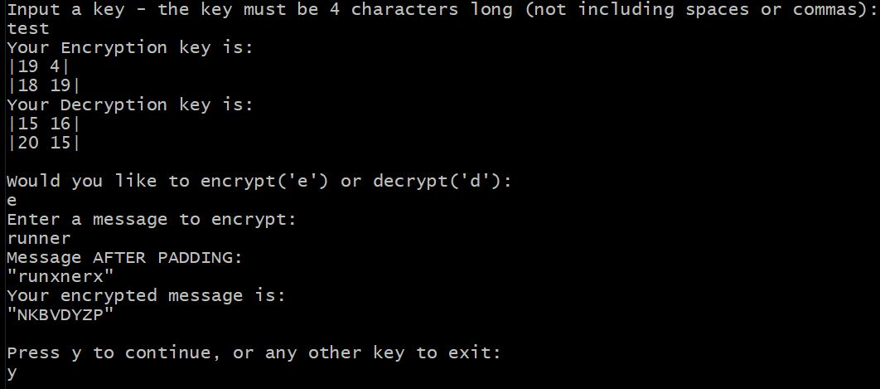
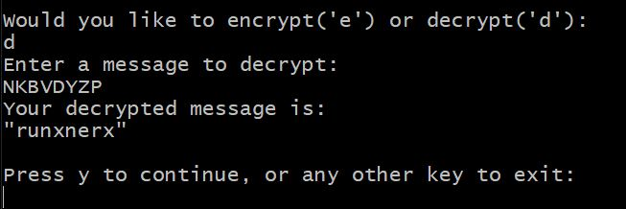
Program Examples Cont
Example of successful run using message ‘runner’ and key ‘test’

Slide 11
Works Cited
Image 01: Hill cipher. (n.d.). Retrieved February 26, 2021, from https://crypto.interactive-maths.com/hill-cipher.html
Image 02: C program to find determinant of a matrix. (n.d.). Retrieved February 26, 2021, from https://www.cprogramcoding.com/p/box-sizing-border-box_474.html
Before Encrypting, Encryption, and Decryption instructions: Hill cipher. (2021, January 30). Retrieved February 26, 2021, from https://en.wikipedia.org/wiki/Hill_cipher
Image 03: Hill cipher. (n.d.). Retrieved February 26, 2021, from https://crypto.interactive-maths.com/hill-cipher.html
Adjugate Matrix: Adjugate matrix. (2021, February 25). Retrieved February 26, 2021, from https://en.wikipedia.org/wiki/Adjugate_matrix
Image 04: Hill cipher. (n.d.). Retrieved February 26, 2021, from https://crypto.interactive-maths.com/hill-cipher.html

